Slide 1
Modeling and Simulation of Magnetic Transmission Lines
Muhammad Shamaas
2018-MS-EE-4

Slide 2
Research Objectives
Model and simulate dispersive, inhomogeneous and non-linear Magnetic Transmission Lines using Finite Difference Time Domain Method.
Study Frequency Domain Behavior of Magnetic Transmission Lines by Decomposition of Fields into various travelling wave modes.
Develop lumped Magnetic Transmission Line circuit.
Simulate cross talk between Multi-Conductor Magnetic Transmission Lines.
Develop Power Flow Equations for Magnetic Transmission Lines in terms of Lumped parameters.

Slide 3
Introduction to Magnetic Transmission Lines
Magnetic Transmission Lines are made from a magnetic material, with a very high relative permeability. They are very poor electrical conductors.
Electric Current can generate Magnetomotive Force and Electromotive force produces magnetic current.
The operation of a Magnetic Transmission Line does not involve electric charges. However, changing Magnetic Fields produce Electric Fields and Electrical Energy is stored in the dielectric medium.
Electromagnetic Energy flows simultaneously in Electrical and Magnetic domains. Normally, only one domain is studied at a time.
The Magnetic Transmission Line behavior must be modeled using Maxwell’s Equations and magnetic circuits to study the time and frequency domain behavior of Magnetic Transmission Lines.

Slide 4
Applications of Magnetic Transmission Lines
Inductors and Magnetic Amplifiers.
Transformers: Power Transformers, Ferro-resonant Constant Voltage Transformers, Wideband Transformers, Pulse Transformers.
Alternating Current and Direct Current Machines.
Computers and High Frequency Electronics.
Noise and skin effect suppression using magnetic thin films, ferrite beads and ribbons.
Directional Couplers and Magnetometers.
Induction Heaters and Magneto-resistive Sensors.
Gyromagnetic Devices, Microwave generators and Magnetic Resonance Imaging.

Slide 5
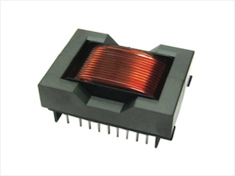
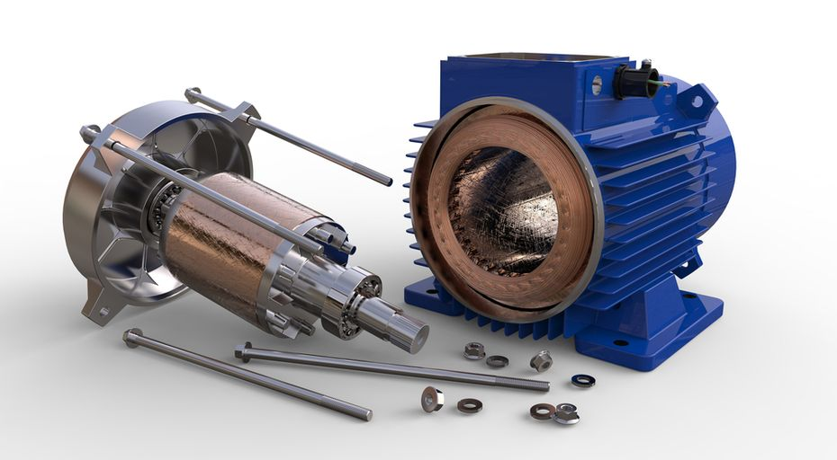
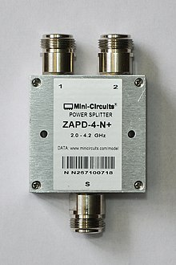
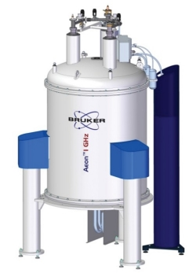
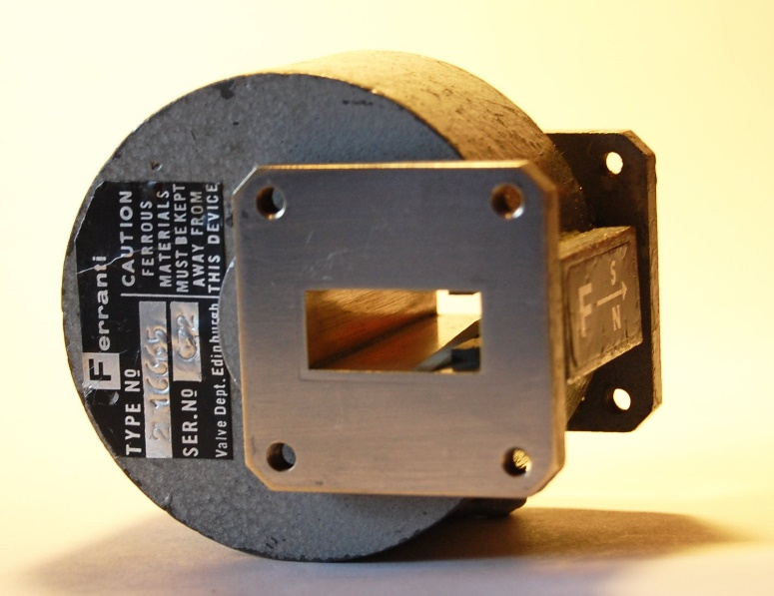
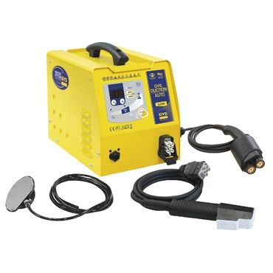
Applications of Magnetic Transmission Lines

Slide 6
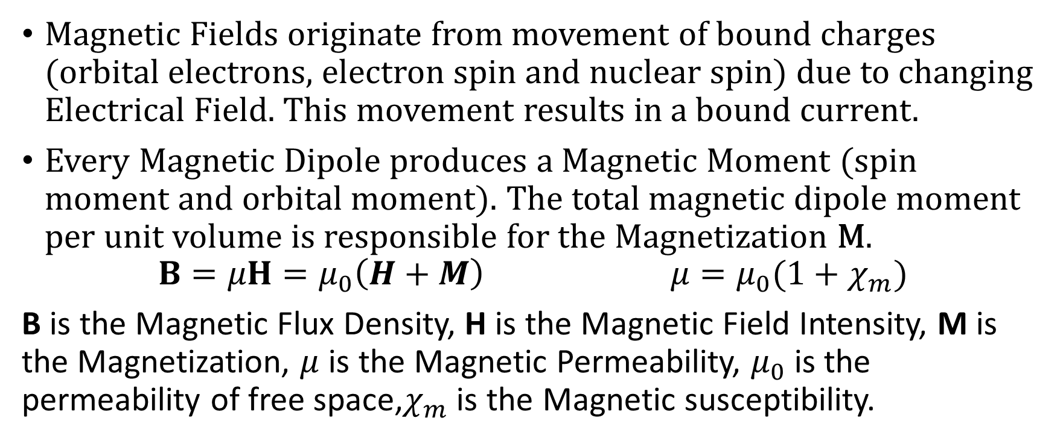
Magnetization and Permeability
Magnetic Fields originate from movement of bound charges (orbital electrons, electron spin and nuclear spin) due to changing Electrical Field. This movement results in a bound current.
Every Magnetic Dipole produces a Magnetic Moment (spin moment and orbital moment). The total magnetic dipole moment per unit volume is responsible for the Magnetization M.
$$B=μH=μ_{0}\left(H+M\right) μ=μ_{0}(1+χ_{m})$$
B is the Magnetic Flux Density, H is the Magnetic Field Intensity, M is the Magnetization, $μ$ is the Magnetic Permeability, $μ_{0}$ is the permeability of free space,$χ_{m}$is the Magnetic susceptibility.

Slide 7
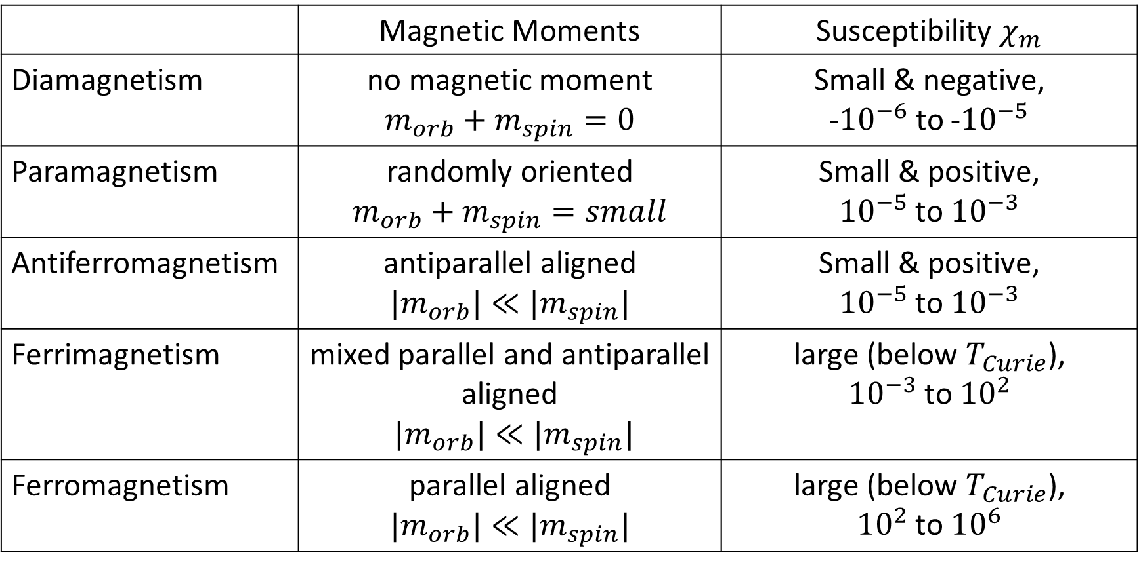
Properties of Magnetic Materials
 | Magnetic Moments | Susceptibility $χ_{m}$
Diamagnetism | no magnetic moment $$m_{orb}+m_{spin}=0$$ | Small & negative, -${10}^{−6}$ to -${10}^{−5}$
Paramagnetism | randomly oriented $$m_{orb}+m_{spin}=small$$ | Small & positive, ${10}^{−5}$ to ${10}^{−3}$
Antiferromagnetism | antiparallel aligned $$|m_{orb}|≪|m_{spin}|$$ | Small & positive, ${10}^{−5}$ to ${10}^{−3}$
Ferrimagnetism | mixed parallel and antiparallel aligned $|m_{orb}|≪|m_{spin}|$ | large (below $T_{Curie}$), ${10}^{−3}$ to ${10}^{2}$
Ferromagnetism | parallel aligned $$|m_{orb}|≪|m_{spin}|$$ | large (below $T_{Curie}$), ${10}^{2}$ to ${10}^{6}$

Slide 8
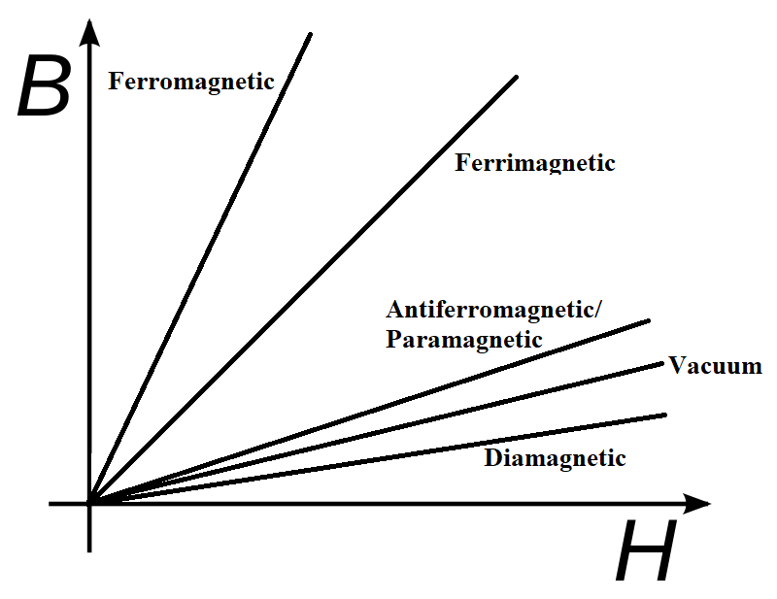
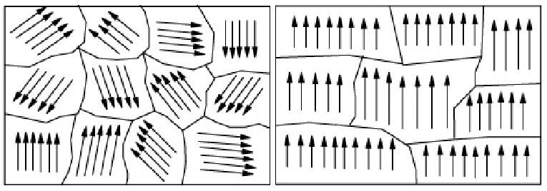
Properties of Magnetic Materials

Slide 9
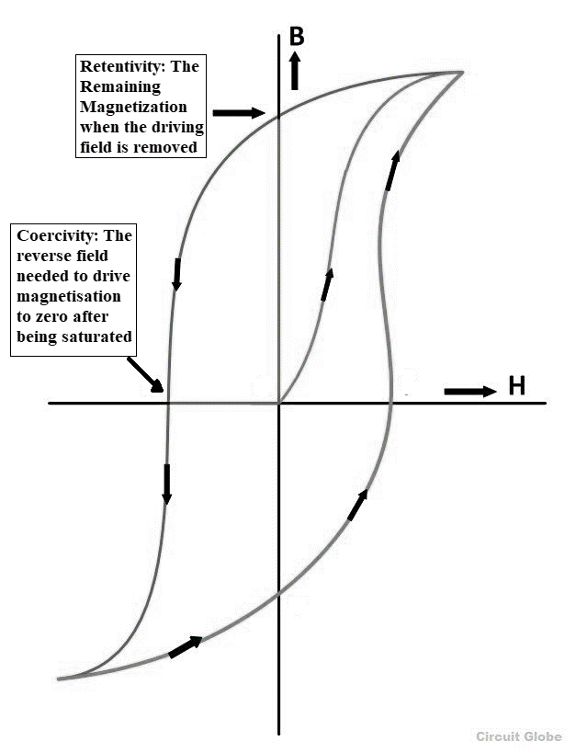
Magnetic Hysteresis
Ferromagnetic materials are non-linear as their permeability varies with the strength of applied field intensity.
The flux in a ferromagnetic material depends on the instantaneous Magnetomotive force and its history.
At high magnetic field intensity, the material saturates, limiting further increase of Magnetic Flux.

Slide 10
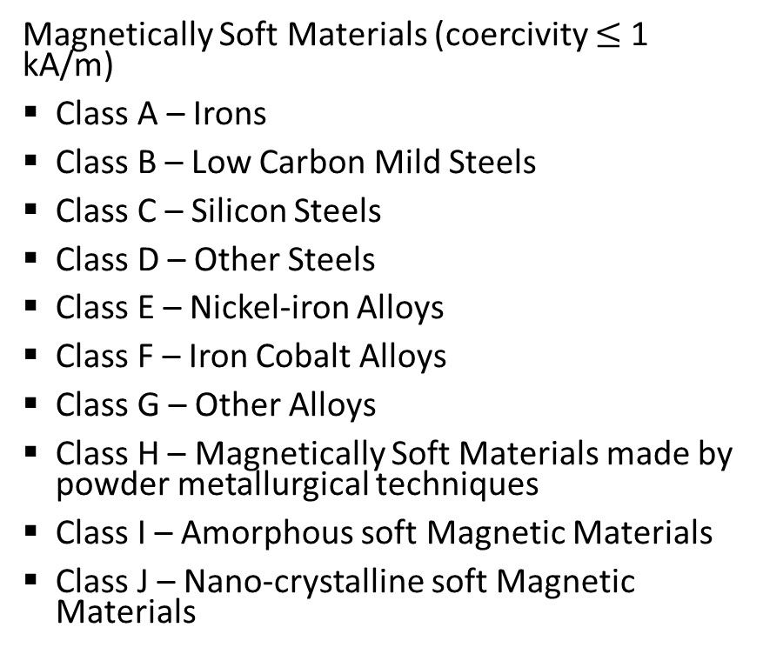
IEC 60404-1:2016 Classification of Magnetic Materials
Magnetically Soft Materials (coercivity $≤$ 1 kA/m)
Class A – Irons
Class B – Low Carbon Mild Steels
Class C – Silicon Steels
Class D – Other Steels
Class E – Nickel-iron Alloys
Class F – Iron Cobalt Alloys
Class G – Other Alloys
Class H – Magnetically Soft Materials made by powder metallurgical techniques
Class I – Amorphous soft Magnetic Materials
Class J – Nano-crystalline soft Magnetic Materials
Magnetically Hard Materials (coercivity > 1kA/m)
Class Q – Magnetostrictive Alloys – Rare Earth iron Alloys
Class R – Magnetically Hard Alloys
Class S – Magnetically hard ceramics – Hard Ferrites
Class T – Other Magnetically Hard Materials – Martensitic Steels
Class U – Bonded Magnetically Hard Materials

Slide 11
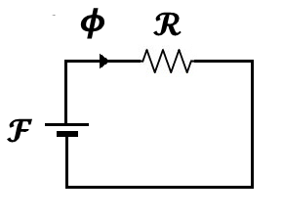
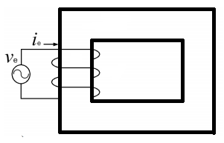
Lossy Complex Magnetic Reluctance Model for Magnetic Circuits

Slide 12
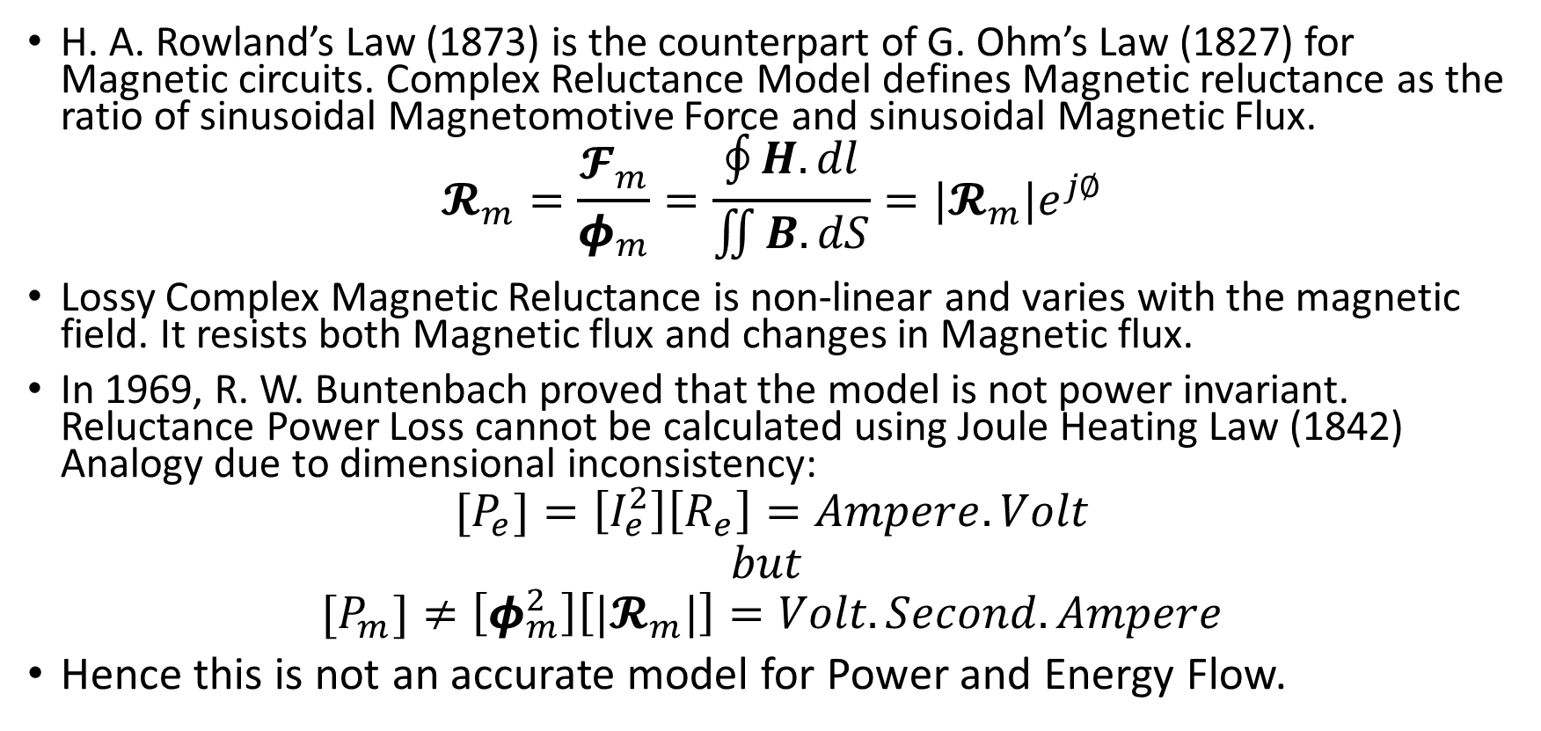
Lossy Complex Magnetic Reluctance Model for Magnetic Circuits
H. A. Rowland’s Law (1873) is the counterpart of G. Ohm’s Law (1827) for Magnetic circuits. Complex Reluctance Model defines Magnetic reluctance as the ratio of sinusoidal Magnetomotive Force and sinusoidal Magnetic Flux.
$$𝓡_{m}=\frac{𝓕_{m}}{φ_{m}}=\frac{\oint{H.dl}}{\iint{B.dS}}=|𝓡_{m}|e^{j∅}$$
Lossy Complex Magnetic Reluctance is non-linear and varies with the magnetic field. It resists both Magnetic flux and changes in Magnetic flux.
In 1969, R. W. Buntenbach proved that the model is not power invariant. Reluctance Power Loss cannot be calculated using Joule Heating Law (1842) Analogy due to dimensional inconsistency:
$$[P_{e}]=\left[I_{e}^{2}\right]\left[R_{e}\right]=Ampere.Volt$$
$$but$$
$${[P}_{m}]≠\left[φ_{m}^{2}\right]\left[|𝓡_{m}|\right]=Volt.Second.Ampere$$
Hence this is not an accurate model for Power and Energy Flow.

Slide 13
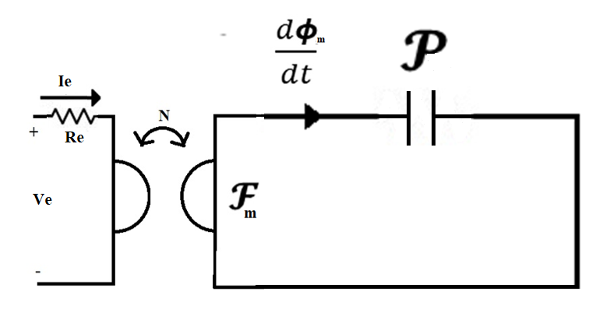
Power Invariant Permeance-Capacitance Model
B. Tellegen’s Gyrator theory (1948) can describe power invariant transformation of magnetic and electric quantities. The dual effort and flow quantities are related by the gyration constant (N). R. W. Buntenbach proposed Power Invariant Permeance-Capacitance Model (1969) to replace Reluctance Model.

Slide 14
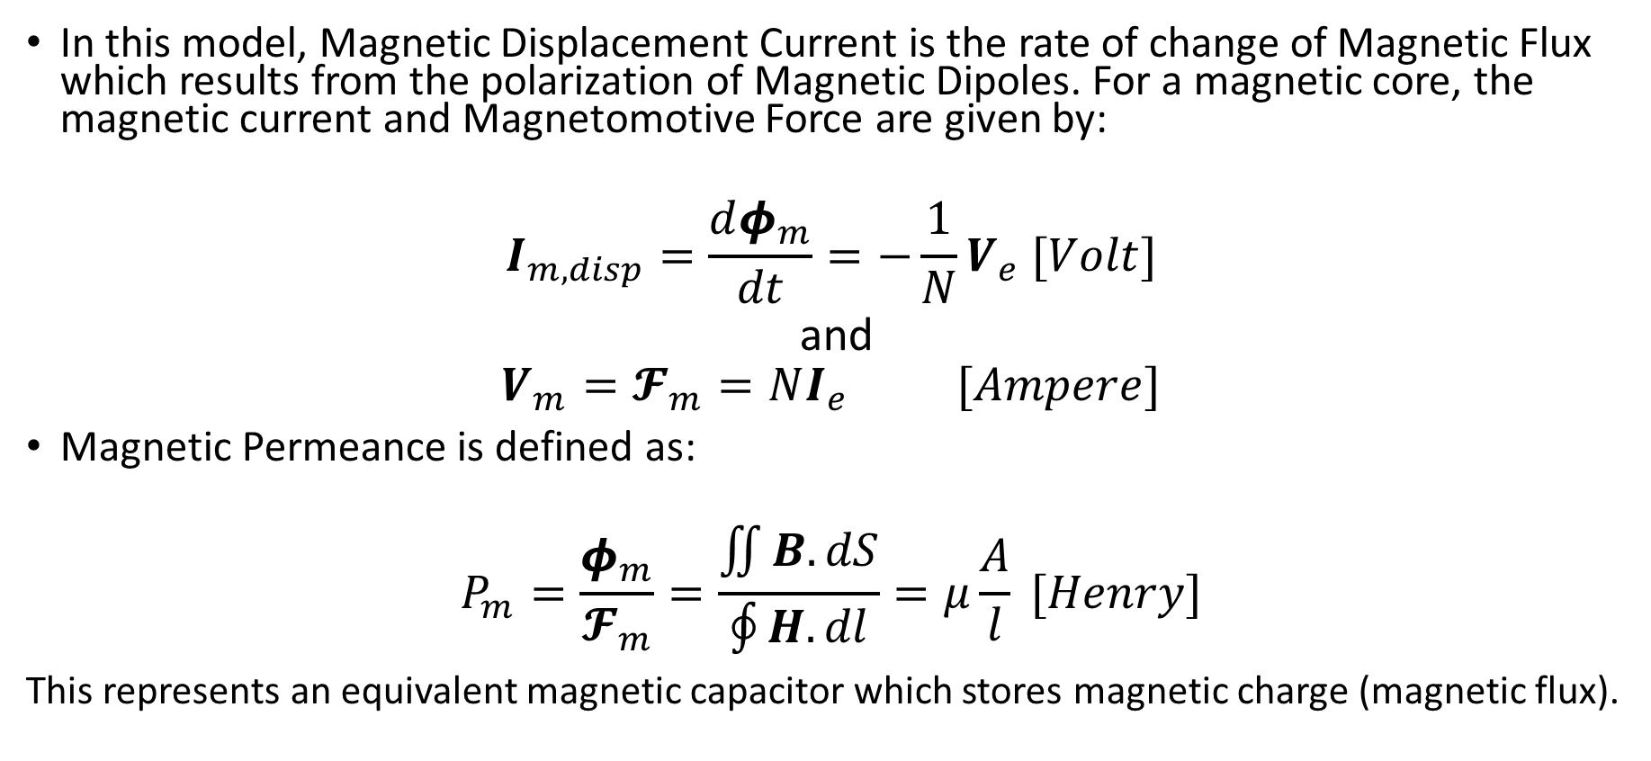
Power Invariant Permeance-Capacitance Model
In this model, Magnetic Displacement Current is the rate of change of Magnetic Flux which results from the polarization of Magnetic Dipoles. For a magnetic core, the magnetic current and Magnetomotive Force are given by:
$$I_{m,disp}=\frac{dφ_{m}}{dt}=−\frac{1}{N}V_{e} [Volt]$$
and
$$V_{m}=𝓕_{m}=NI_{e} [Ampere]$$
Magnetic Permeance is defined as:
$$P_{m}=\frac{φ_{m}}{𝓕_{m}}=\frac{\iint{B.dS}}{\oint{H.dl}}=μ\frac{A}{l} [Henry]$$
This represents an equivalent magnetic capacitor which stores magnetic charge (magnetic flux).

Slide 15
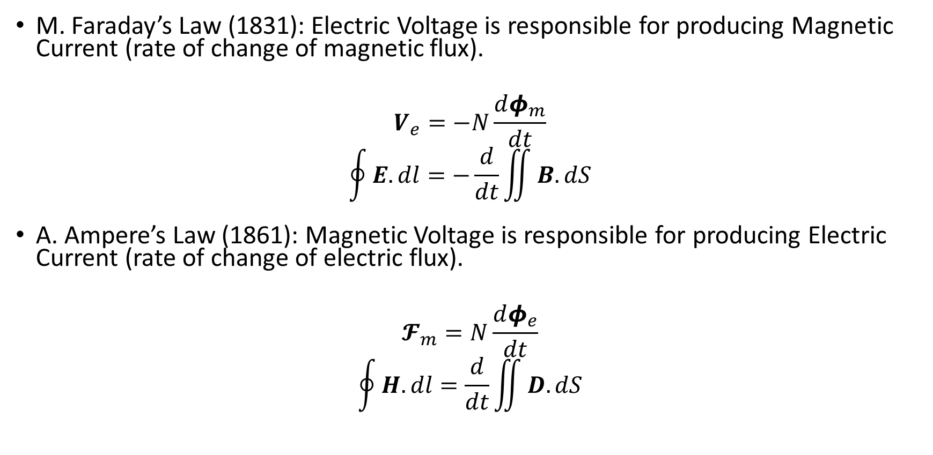
Validation of Permeance-Capacitance Model
M. Faraday’s Law (1831): Electric Voltage is responsible for producing Magnetic Current (rate of change of magnetic flux).
$$V_{e}=−N\frac{dφ_{m}}{dt}$$
$$\oint{E.dl}=−\frac{d}{dt}\iint{B.dS}$$
A. Ampere’s Law (1861): Magnetic Voltage is responsible for producing Electric Current (rate of change of electric flux).
$$𝓕_{m}=N\frac{dφ_{e}}{dt}$$
$$\oint{H.dl}=\frac{d}{dt}\iint{D.dS}$$

Slide 16
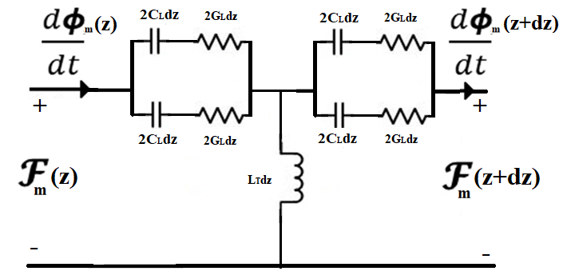
Magnetic Transmission Line Model
J. A. B. Faria and M.P. Pires presented Magnetic Transmission Line Model (2012) based on Electric Transmission Line Model.

Slide 17
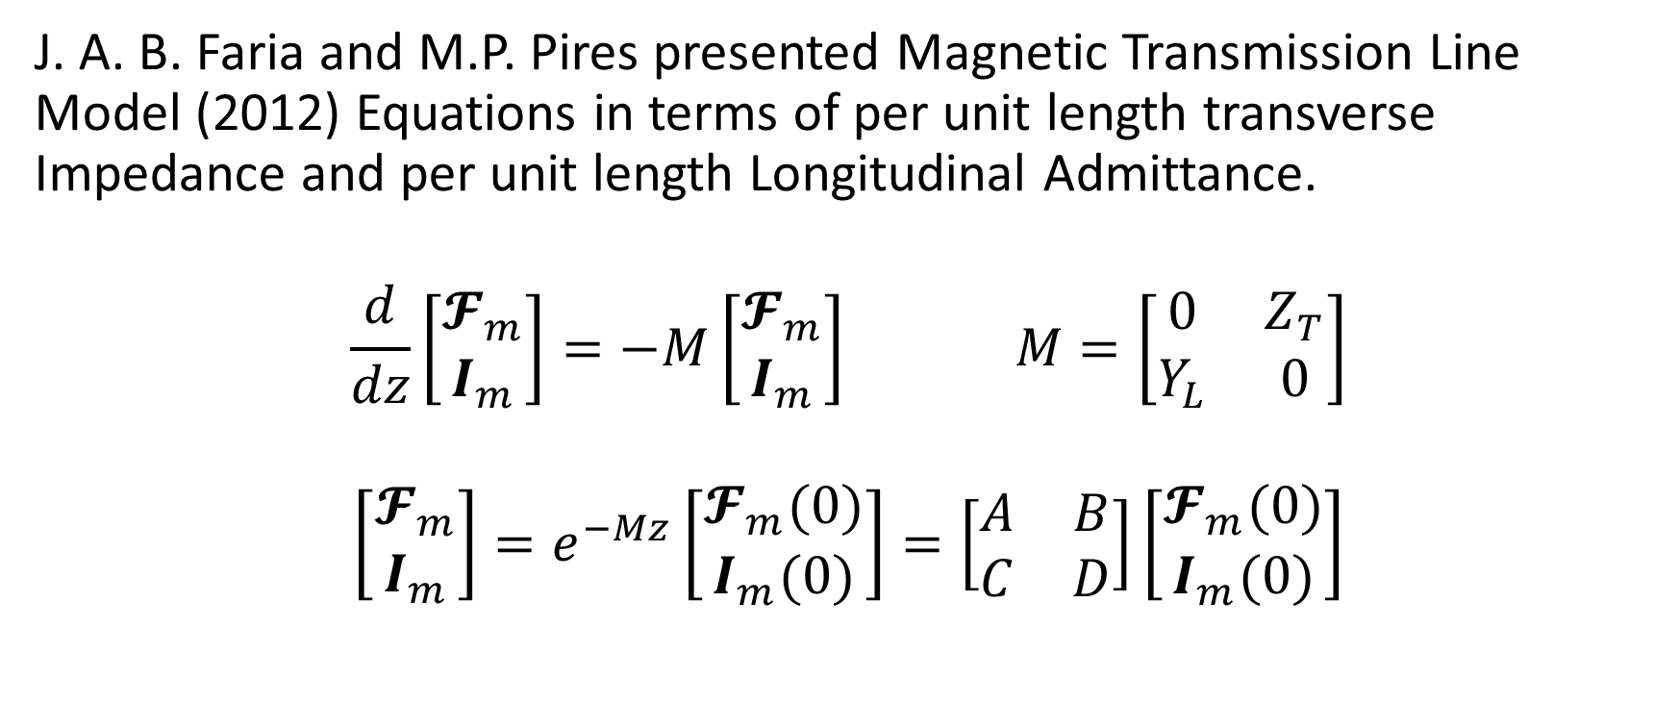
Magnetic Transmission Line Model
J. A. B. Faria and M.P. Pires presented Magnetic Transmission Line Model (2012) Equations in terms of per unit length transverse Impedance and per unit length Longitudinal Admittance.
$$\frac{d}{dz}\left[\begin{matrix}𝓕_{m} \\ I_{m}\end{matrix}\right]=−M\left[\begin{matrix}𝓕_{m} \\ I_{m}\end{matrix}\right] M=\left[\begin{matrix}0 & Z_{T} \\ Y_{L} & 0\end{matrix}\right]$$
$$\left[\begin{matrix}𝓕_{m} \\ I_{m}\end{matrix}\right]=e^{−Mz}\left[\begin{matrix}𝓕_{m}(0) \\ I_{m}(0)\end{matrix}\right]=\left[\begin{matrix}A & B \\ C & D\end{matrix}\right]\left[\begin{matrix}𝓕_{m}(0) \\ I_{m}(0)\end{matrix}\right]$$

Slide 18
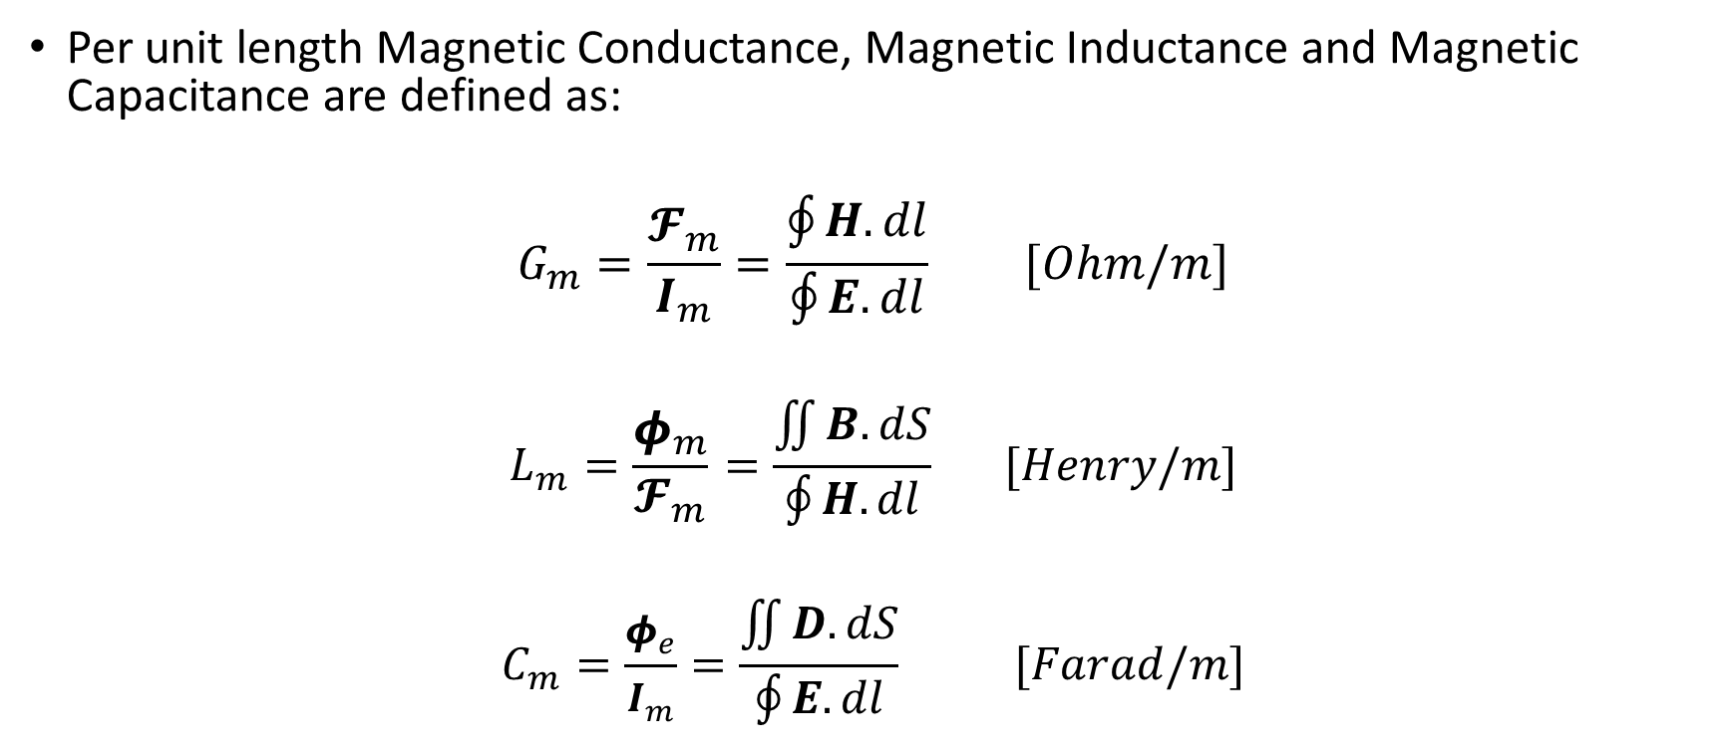
Components in Transmission Line Model
Per unit length Magnetic Conductance, Magnetic Inductance and Magnetic Capacitance are defined as:
$$G_{m}=\frac{𝓕_{m}}{I_{m}}=\frac{\oint{H.dl}}{\oint{E.dl}} [Ohm/m]$$
$$L_{m}=\frac{φ_{m}}{𝓕_{m}}=\frac{\iint{B.dS}}{\oint{H.dl}} [Henry/m]$$
$$C_{m}=\frac{φ_{e}}{I_{m}}=\frac{\iint{D.dS}}{\oint{E.dl}} [Farad/m]$$

Slide 19
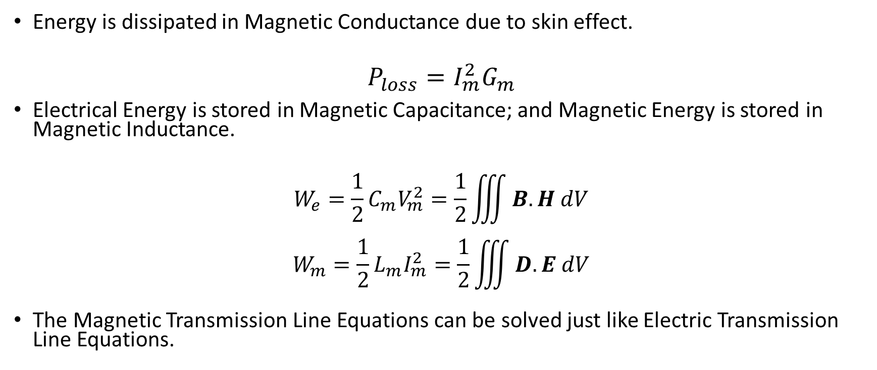
Energy Loss and Energy Storage
Energy is dissipated in Magnetic Conductance due to skin effect.
$$P_{loss}=I_{m}^{2}G_{m}$$
Electrical Energy is stored in Magnetic Capacitance; and Magnetic Energy is stored in Magnetic Inductance.
$$W_{e}=\frac{1}{2}{C_{m}V}_{m}^{2}=\frac{1}{2}\iiint{B.H dV}$$
$$W_{m}=\frac{1}{2}{L_{m}I}_{m}^{2}=\frac{1}{2}\iiint{D.E dV}$$
The Magnetic Transmission Line Equations can be solved just like Electric Transmission Line Equations.

Slide 20
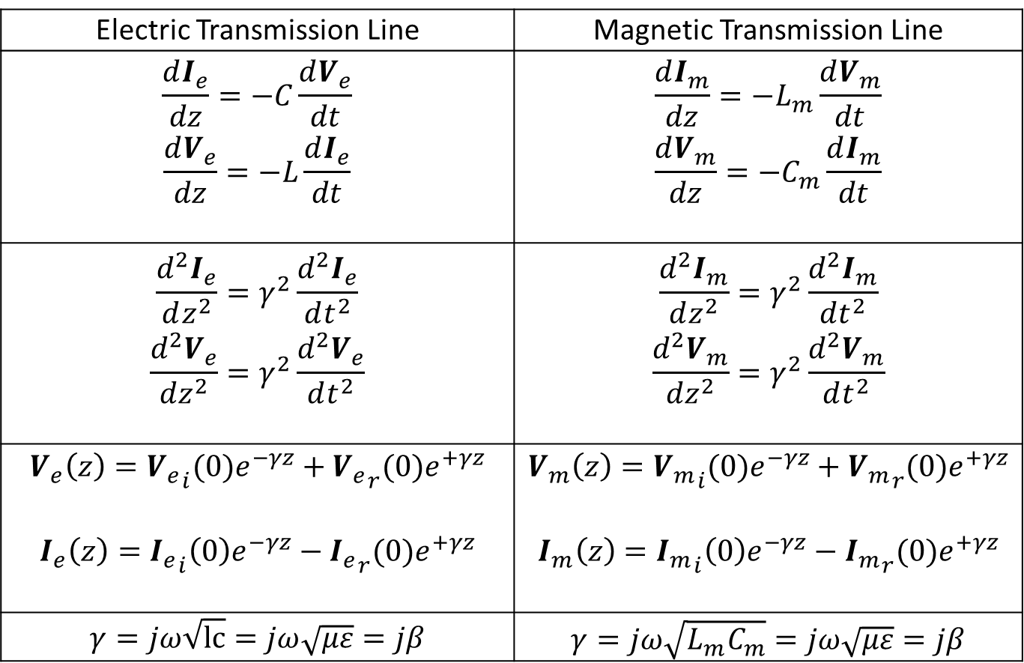
Lossless Transmission Lines
Electric Transmission Line | Magnetic Transmission Line
$$\frac{dI_{e}}{dz}=−C\frac{dV_{e}}{dt}$$ $$\frac{dV_{e}}{dz}=−L\frac{dI_{e}}{dt}$$ | $$\frac{dI_{m}}{dz}=−L_{m}\frac{dV_{m}}{dt}$$ $$\frac{dV_{m}}{dz}=−C_{m}\frac{dI_{m}}{dt}$$
$$\frac{d^{2}I_{e}}{dz^{2}}=γ^{2}\frac{d^{2}I_{e}}{dt^{2}}$$ $$\frac{d^{2}V_{e}}{dz^{2}}=γ^{2}\frac{d^{2}V_{e}}{dt^{2}}$$ | $$\frac{d^{2}I_{m}}{dz^{2}}=γ^{2}\frac{d^{2}I_{m}}{dt^{2}}$$ $$\frac{d^{2}V_{m}}{dz^{2}}=γ^{2}\frac{d^{2}V_{m}}{dt^{2}}$$
$$V_{e}\left(z\right)={V_{e}}_{i}(0)e^{−γz}+{V_{e}}_{r}(0)e^{+γz}$$ $$I_{e}\left(z\right)={I_{e}}_{i}\left(0\right)e^{−γz}−{I_{e}}_{r}(0)e^{+γz}$$ | $$V_{m}\left(z\right)={V_{m}}_{i}(0)e^{−γz}+{V_{m}}_{r}(0)e^{+γz}$$ $$I_{m}\left(z\right)={I_{m}}_{i}\left(0\right)e^{−γz}−{I_{m}}_{r}(0)e^{+γz}$$
$$γ=jω\sqrt{lc}=jω\sqrt{με}=jβ$$ | $$γ=jω\sqrt{L_{m}C_{m}}=jω\sqrt{με}=jβ$$

Slide 21
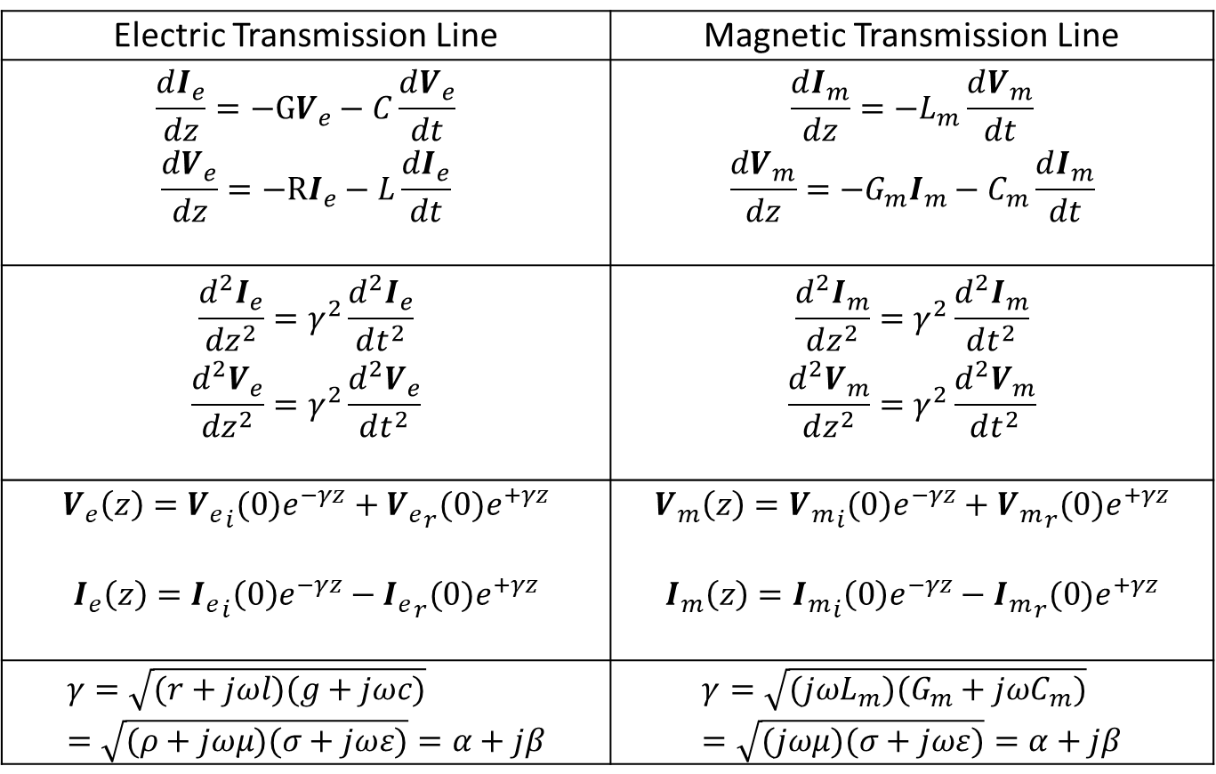
Lossy Transmission Lines
Electric Transmission Line | Magnetic Transmission Line
$$\frac{dI_{e}}{dz}=−GV_{e}−C\frac{dV_{e}}{dt}$$ $$\frac{dV_{e}}{dz}=−RI_{e}−L\frac{dI_{e}}{dt}$$ | $$\frac{dI_{m}}{dz}=−L_{m}\frac{dV_{m}}{dt}$$ $$\frac{dV_{m}}{dz}=−G_{m}I_{m}−C_{m}\frac{dI_{m}}{dt}$$
$$\frac{d^{2}I_{e}}{dz^{2}}=γ^{2}\frac{d^{2}I_{e}}{dt^{2}}$$ $$\frac{d^{2}V_{e}}{dz^{2}}=γ^{2}\frac{d^{2}V_{e}}{dt^{2}}$$ | $$\frac{d^{2}I_{m}}{dz^{2}}=γ^{2}\frac{d^{2}I_{m}}{dt^{2}}$$ $$\frac{d^{2}V_{m}}{dz^{2}}=γ^{2}\frac{d^{2}V_{m}}{dt^{2}}$$
$$V_{e}\left(z\right)={V_{e}}_{i}(0)e^{−γz}+{V_{e}}_{r}(0)e^{+γz}$$ $$I_{e}\left(z\right)={I_{e}}_{i}\left(0\right)e^{−γz}−{I_{e}}_{r}(0)e^{+γz}$$ | $$V_{m}\left(z\right)={V_{m}}_{i}(0)e^{−γz}+{V_{m}}_{r}(0)e^{+γz}$$ $$I_{m}\left(z\right)={I_{m}}_{i}\left(0\right)e^{−γz}−{I_{m}}_{r}(0)e^{+γz}$$
$$γ=\sqrt{(r+jωl)(g+jωc)}=\sqrt{(ρ+jωμ)(σ+jωε)}=α+jβ$$ | $$γ=\sqrt{(jωL_{m})(G_{m}+jωC_{m})}=\sqrt{(jωμ)(σ+jωε)}=α+jβ$$

Slide 22
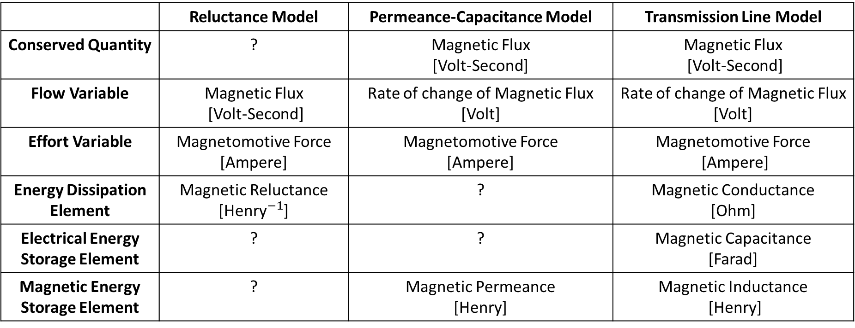
Comparison of Different Models
 | Reluctance Model | Permeance-Capacitance Model | Transmission Line Model
Conserved Quantity | ? | Magnetic Flux [Volt-Second] | Magnetic Flux [Volt-Second]
Flow Variable | Magnetic Flux [Volt-Second] | Rate of change of Magnetic Flux [Volt] | Rate of change of Magnetic Flux [Volt]
Effort Variable | Magnetomotive Force [Ampere] | Magnetomotive Force [Ampere] | Magnetomotive Force [Ampere]
Energy Dissipation Element | Magnetic Reluctance [${\text{Henry}}^{−1}$] | ? | Magnetic Conductance [Ohm]
Electrical Energy Storage Element | ? | ? | Magnetic Capacitance [Farad]
Magnetic Energy Storage Element | ? | Magnetic Permeance [Henry] | Magnetic Inductance [Henry]

Slide 23
Introduction to MEEP
MEEP (2006) is a script based Simulator for Electromagnetics.
MEEP is ideal for modeling the time domain and frequency domain behavior of a variety of arbitrary materials including anisotropic, dispersive, non-linear dielectrics, electric/ magnetic conductors, media with saturable gain / absorption, and gyrotropic media.
The C++ interface has the features of variable resolution and normalized units.
Sample data for several materials is provided in libraries for building accurate test structures.
A wide variety of electric or magnetic current sources can be simulated.
Many derived components like Energy Density and Poynting Flux can be evaluated.
Several Mathematical operations like averaging, symmetry and integration are allowed in cylindrical and rectangular coordinates.
The fields can be printed as image or video files as well.

Slide 24
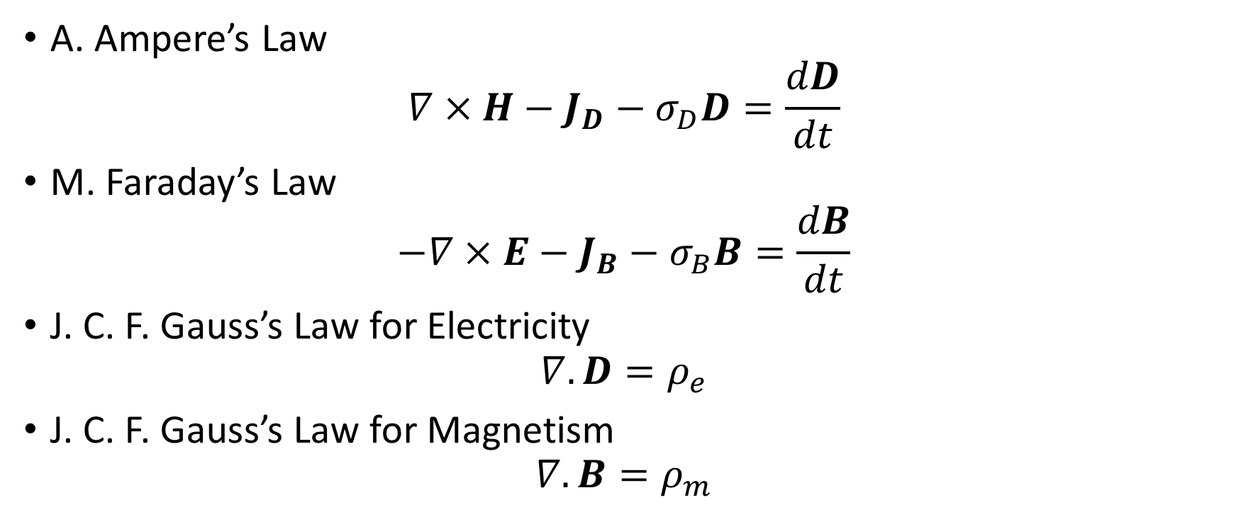
MEEP: Fully Symmetric Maxwell’s Equations (1861) with Fictitious Magnetic Monopoles
A. Ampere’s Law
$$∇×H−J_{D}−σ_{D}D=\frac{dD}{dt}$$
M. Faraday’s Law
$$−∇×E−J_{B}−σ_{B}B=\frac{dB}{dt}$$
J. C. F. Gauss’s Law for Electricity
$$∇.D=ρ_{e}$$
J. C. F. Gauss’s Law for Magnetism
$$∇.B=ρ_{m}$$

Slide 25
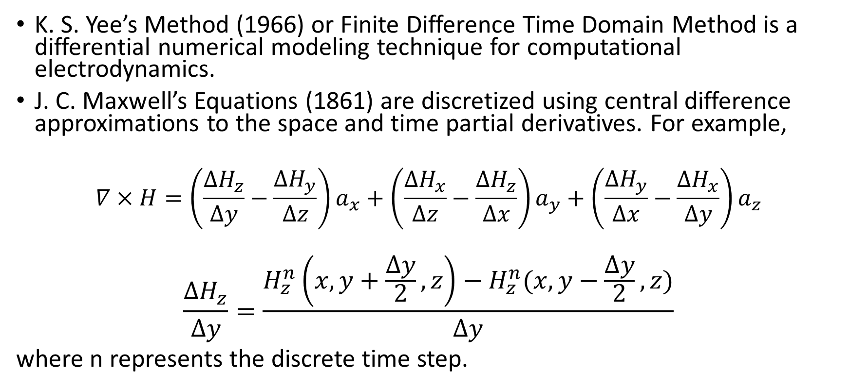
MEEP: Finite Difference Time Domain Method
K. S. Yee’s Method (1966) or Finite Difference Time Domain Method is a differential numerical modeling technique for computational electrodynamics.
J. C. Maxwell’s Equations (1861) are discretized using central difference approximations to the space and time partial derivatives. For example,
$$∇×H=\left(\frac{∆H_{z}}{∆y}−\frac{∆H_{y}}{∆z}\right)a_{x}+\left(\frac{∆H_{x}}{∆z}−\frac{∆H_{z}}{∆x}\right)a_{y}+\left(\frac{∆H_{y}}{∆x}−\frac{∆H_{x}}{∆y}\right)a_{z}$$
$$\frac{∆H_{z}}{∆y}=\frac{H_{z}^{n}\left(x,y+\frac{∆y}{2},z\right)−H_{z}^{n}(x,y−\frac{∆y}{2},z)}{∆y}$$
where n represents the discrete time step.

Slide 26
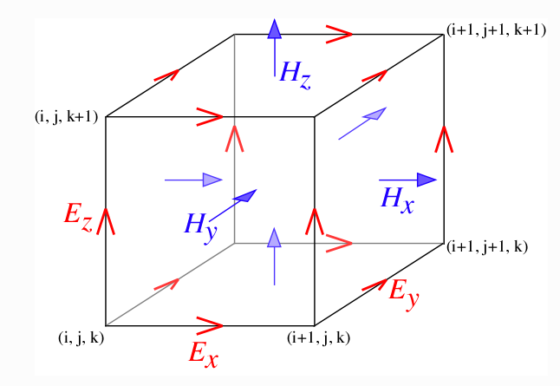
MEEP: Yee Lattice
Finite Difference Time Domain Method discretizes space into a grid of small elements called Yee Lattice (1966). The different field components at a grid location are stored in the edges and faces of a cubic element. They are evolved in discrete time steps.

Slide 27
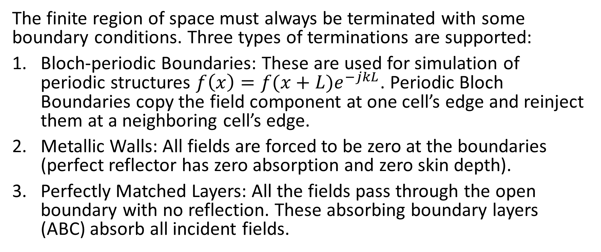
MEEP: Boundary Conditions
The finite region of space must always be terminated with some boundary conditions. Three types of terminations are supported:
Bloch-periodic Boundaries: These are used for simulation of periodic structures $f\left(x\right)=f(x+L)e^{−jkL}$. Periodic Bloch Boundaries copy the field component at one cell’s edge and reinject them at a neighboring cell’s edge.
Metallic Walls: All fields are forced to be zero at the boundaries (perfect reflector has zero absorption and zero skin depth).
Perfectly Matched Layers: All the fields pass through the open boundary with no reflection. These absorbing boundary layers (ABC) absorb all incident fields.

Slide 28
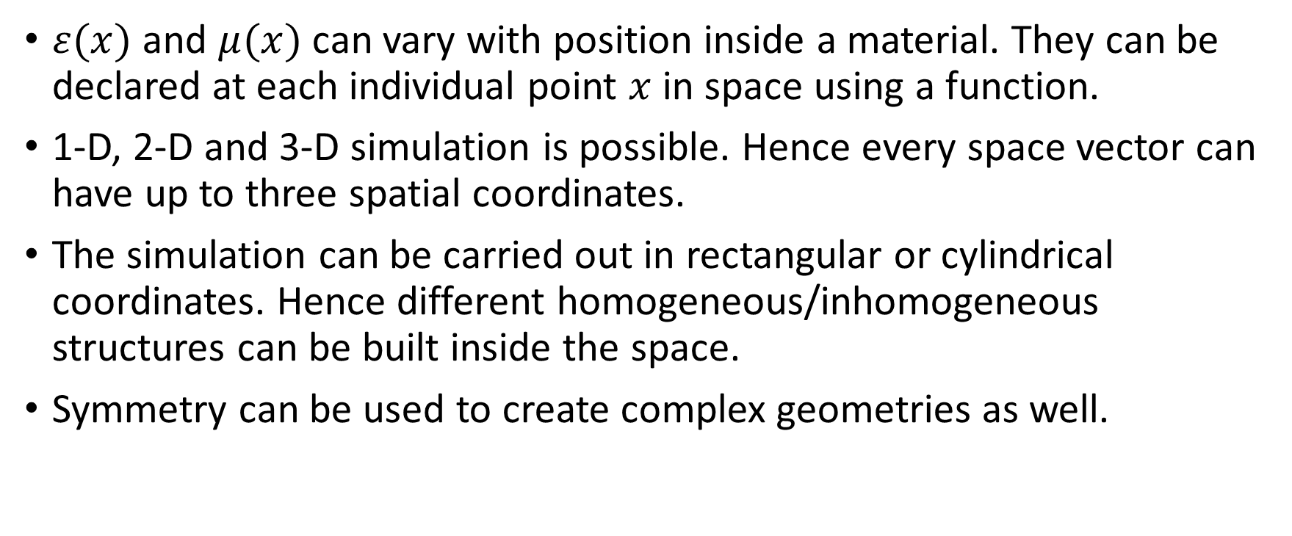
MEEP: Material Inhomogeneity
$ε(x)$ and $μ(x)$ can vary with position inside a material. They can be declared at each individual point $x$ in space using a function.
1-D, 2-D and 3-D simulation is possible. Hence every space vector can have up to three spatial coordinates.
The simulation can be carried out in rectangular or cylindrical coordinates. Hence different homogeneous/inhomogeneous structures can be built inside the space.
Symmetry can be used to create complex geometries as well.

Slide 29
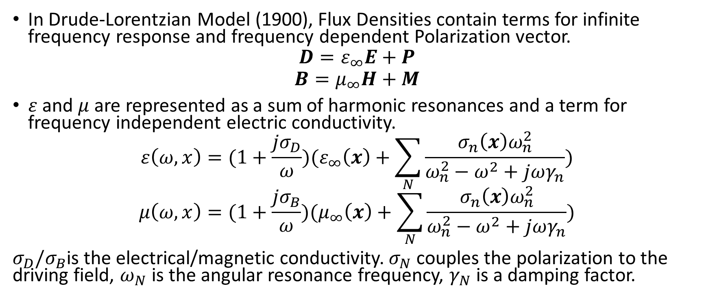
MEEP: Material Dispersion
In Drude-Lorentzian Model (1900), Flux Densities contain terms for infinite frequency response and frequency dependent Polarization vector.
$$D=ε_{∞}E+P$$
$$B=μ_{∞}H+M$$
$ε$ and $μ$are represented as a sum of harmonic resonances and a term for frequency independent electric conductivity.
$$ε\left(ω,x\right)=(1+\frac{jσ_{D}}{ω})(ε_{∞}\left(x\right)+\sum_{N}{\frac{σ_{n}\left(x\right)ω_{n}^{2}}{ω_{n}^{2}−ω^{2}+jωγ_{n}}})$$
$$μ\left(ω,x\right)=(1+\frac{jσ_{B}}{ω})(μ_{∞}\left(x\right)+\sum_{N}{\frac{σ_{n}\left(x\right)ω_{n}^{2}}{ω_{n}^{2}−ω^{2}+jωγ_{n}}})$$
$σ_{D}/σ_{B}$is the electrical/magnetic conductivity. $σ_{N}$ couples the polarization to the driving field, $ω_{N}$ is the angular resonance frequency, $γ_{N}$ is a damping factor.

Slide 30
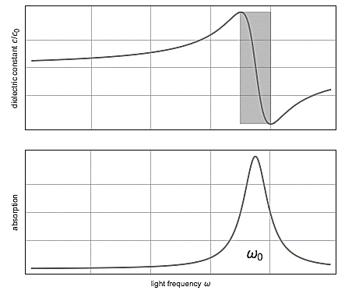
MEEP: Material Dispersion Drude-Lorentzian Model (1900)

Slide 31
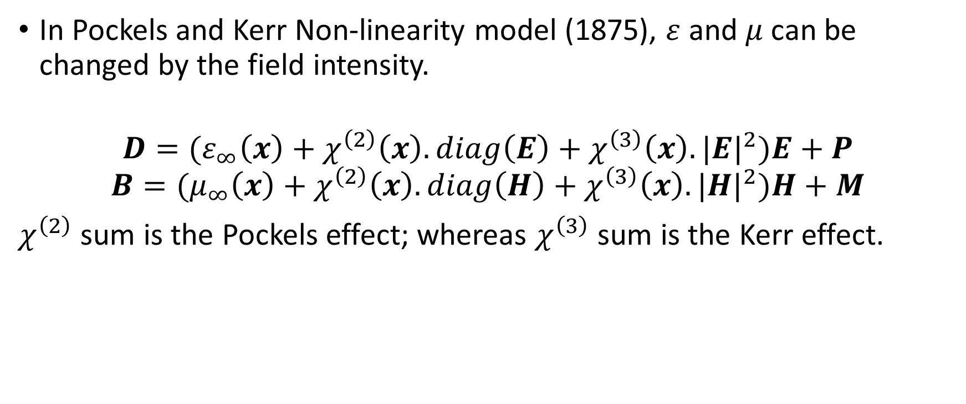
MEEP: Material Non-Linearity
In Pockels and Kerr Non-linearity model (1875), $ε$ and $μ$can be changed by the field intensity.
$$D=(ε_{∞}\left(x\right)+χ^{\left(2\right)}\left(x\right).diag\left(E\right)+χ^{\left(3\right)}\left(x\right).{|E|}^{2})E+P$$
$$B=(μ_{∞}\left(x\right)+χ^{\left(2\right)}\left(x\right).diag\left(H\right)+χ^{\left(3\right)}\left(x\right).{|H|}^{2})H+M$$
$χ^{\left(2\right)}$ sum is the Pockels effect; whereas $χ^{\left(3\right)}$ sum is the Kerr effect.

Slide 32
MEEP: Material Non-Linearity
Ferromagnetic materials are non-linear as their permeability varies with the strength of applied field intensity.
The flux in a ferromagnetic material depends on the instantaneous Magnetomotive force and its history.
At high magnetic field intensity, the material saturates, limiting further increase of Magnetic Flux.

Slide 33
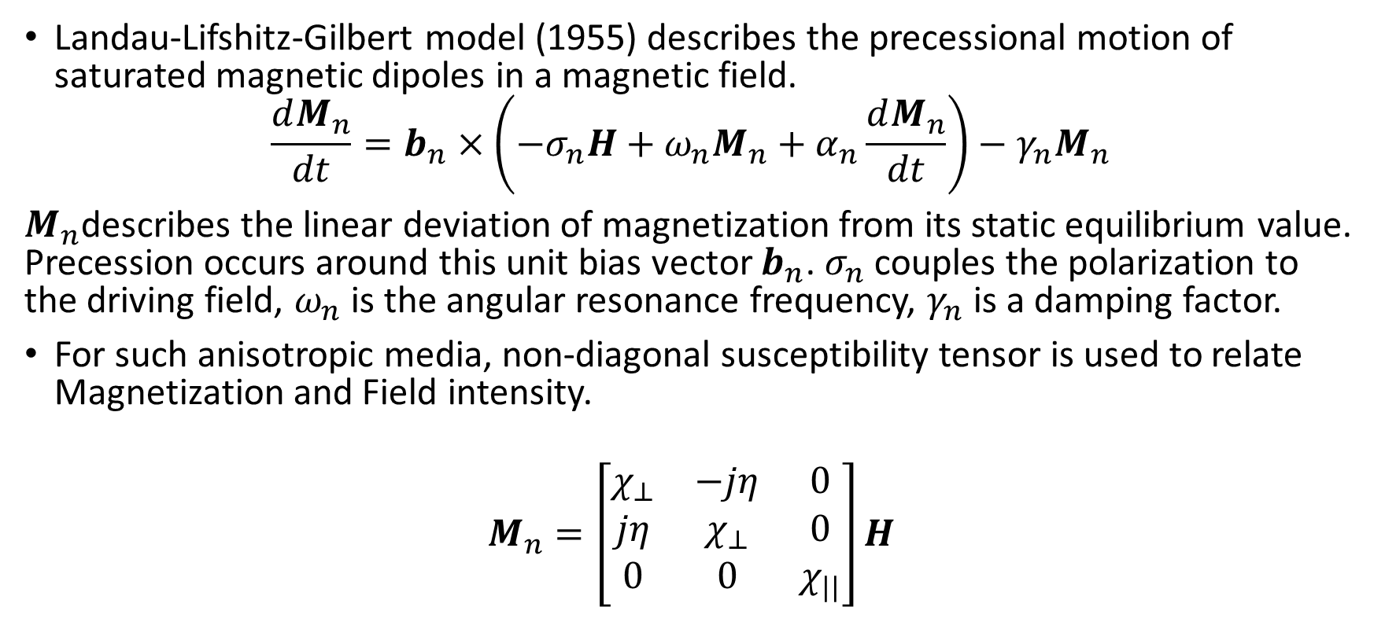
MEEP: Gyromagnetism
Landau-Lifshitz-Gilbert model (1955) describes the precessional motion of saturated magnetic dipoles in a magnetic field.
$$\frac{dM_{n}}{dt}=b_{n}×\left(−σ_{n}H+ω_{n}M_{n}+α_{n}\frac{dM_{n}}{dt}\right)−γ_{n}M_{n}$$
$M_{n}$describes the linear deviation of magnetization from its static equilibrium value. Precession occurs around this unit bias vector $b_{n}$. $σ_{n}$ couples the polarization to the driving field, $ω_{n}$ is the angular resonance frequency, $γ_{n}$ is a damping factor.
For such anisotropic media, non-diagonal susceptibility tensor is used to relate Magnetization and Field intensity.
$$M_{n}=\left[\begin{matrix}χ_{⊥} & −jη & 0 \\ jη & χ_{⊥} & 0 \\ 0 & 0 & χ_{||}\end{matrix}\right]H$$

Slide 34
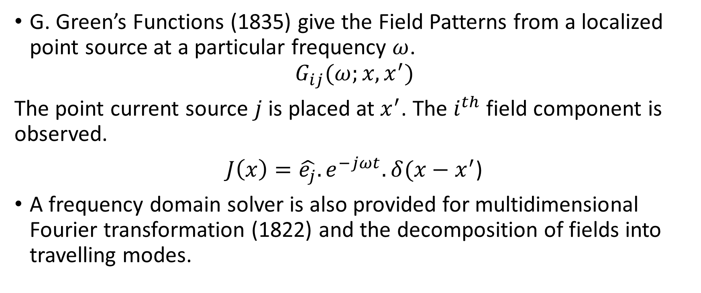
MEEP: Field Patterns and Green’s Functions
G. Green’s Functions (1835) give the Field Patterns from a localized point source at a particular frequency $ω$.
$$G_{ij}(ω;x,x^{′})$$
The point current source $j$ is placed at $x^{′}$. The $i^{th}$ field component is observed.
$J\left(x\right)=\hat{e_{j}}.e^{−jωt}.δ(x−x^{′}$)
A frequency domain solver is also provided for multidimensional Fourier transformation (1822) and the decomposition of fields into travelling modes.

Slide 35
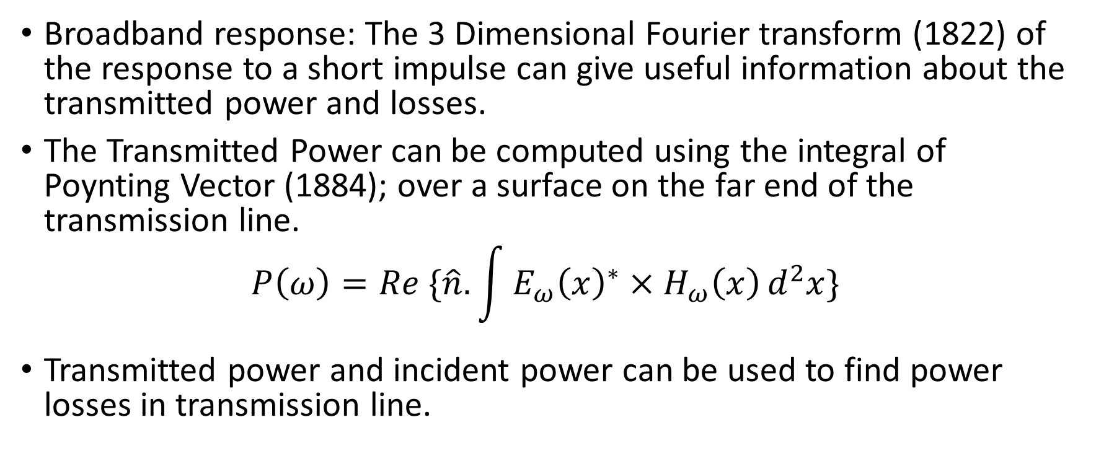
MEEP: Transmittance Spectra
Broadband response: The 3 Dimensional Fourier transform (1822) of the response to a short impulse can give useful information about the transmitted power and losses.
The Transmitted Power can be computed using the integral of Poynting Vector (1884); over a surface on the far end of the transmission line.
$$P\left(ω\right)=Re \{\hat{n}.\int{{E_{ω}\left(x\right)}^{∗}×H_{ω}\left(x\right)}d^{2}x\}$$
Transmitted power and incident power can be used to find power losses in transmission line.

Slide 36
MEEP Simulations for Magnetic Transmission Lines
The Magnetic Transmission Lines will be constructed for inhomogenous, dispersive, non-linear ferromagnetic conductors like Permalloy and Cobalt alloys.
The Transmission Lines will be excited using continuous current sources.
The terminations can be modeled by Perfectly matched layers for complete absorption; or as perfect reflectors for no load.
Different Transmission Line structures can be simulated like shielded transmission line and multi-wire transmission lines.
The multi-dimensional Fourier transform (1822) and mode decomposition will be used to determine Transmittance and Broadband Response.

Slide 37
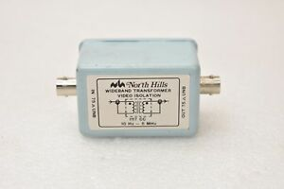
MEEP Simulation for Wideband Transformer
A wideband transformer passes a frequency band of several decades and are usually designed to handle complex waveforms like rectangular pulses. They are used for impedance matching, voltage/ current transformation, DC isolation, mixing, power splitting, coupling and signal inversion.
A wideband transformer will be simulated. It will be excited by a small pulse to examine the Frequency Response. The 3 dimensional Fourier Transform will be used to determine Transmittance and Broadband Response. T-model Equivalent Magnetic circuits and coupled equations will be used to simplify analysis of the transient and steady state behavior.

Slide 38
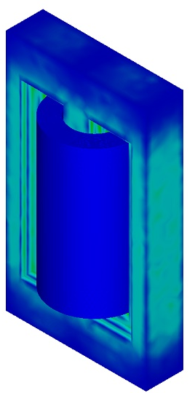
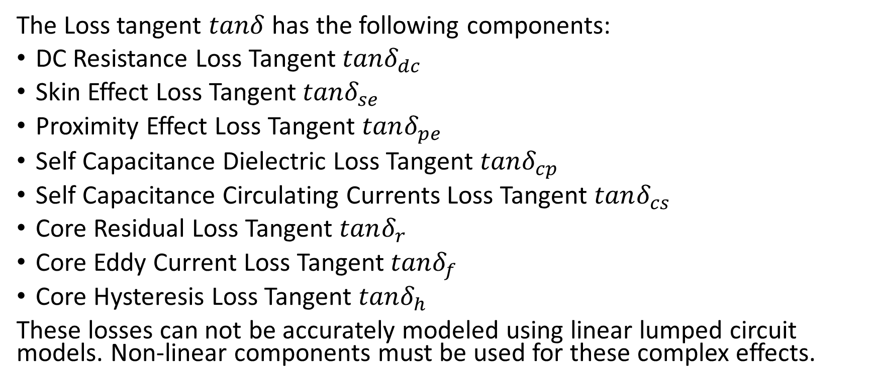
MEEP Simulation for Wideband Transformer: Losses
The Loss tangent $tanδ$ has the following components:
DC Resistance Loss Tangent $tanδ_{dc}$
Skin Effect Loss Tangent $tanδ_{se}$
Proximity Effect Loss Tangent $tanδ_{pe}$
Self Capacitance Dielectric Loss Tangent $tanδ_{cp}$
Self Capacitance Circulating Currents Loss Tangent $tanδ_{cs}$
Core Residual Loss Tangent $tanδ_{r}$
Core Eddy Current Loss Tangent $tanδ_{f}$
Core Hysteresis Loss Tangent $tanδ_{h}$
These losses can not be accurately modeled using linear lumped circuit models. Non-linear components must be used for these complex effects.

Slide 39
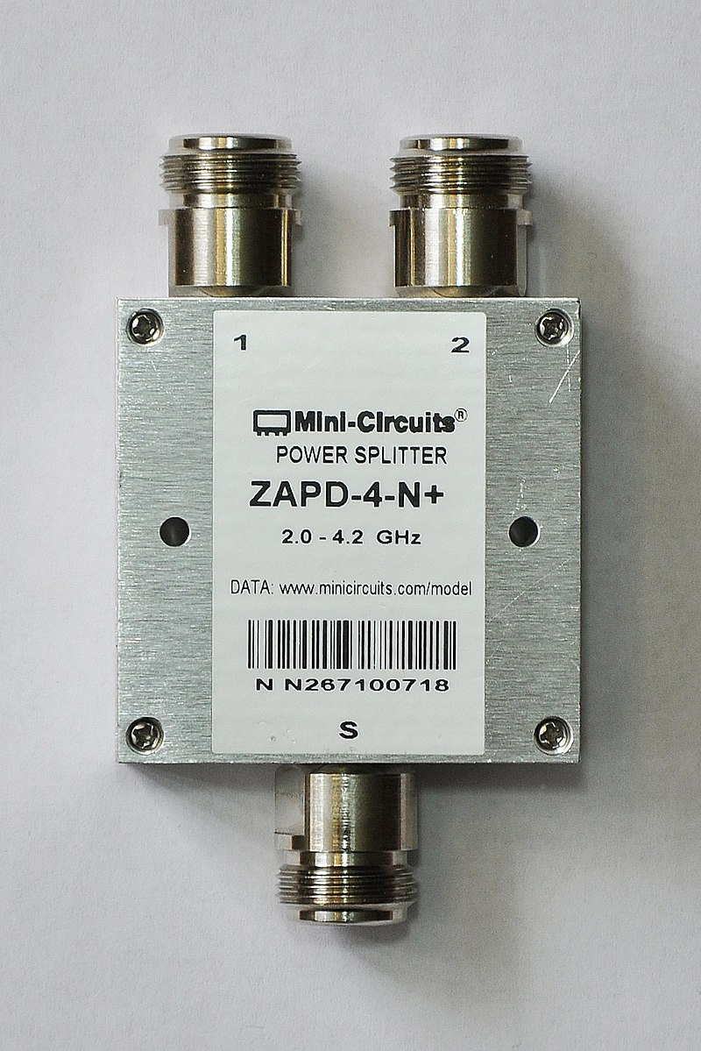
MEEP Simulation for Magnetic Cross Talk and Shielding
Magnetic coupling between magnetic transmission lines results in sharing of electromagnetic energy. This division of power is very useful in design of Radio frequency devices like sensors, antennas and communication systems. Magnetic Coupling is also very important in the working of DC and AC machines like induction motor, hysteresis motor and Reluctance motor.

Slide 40
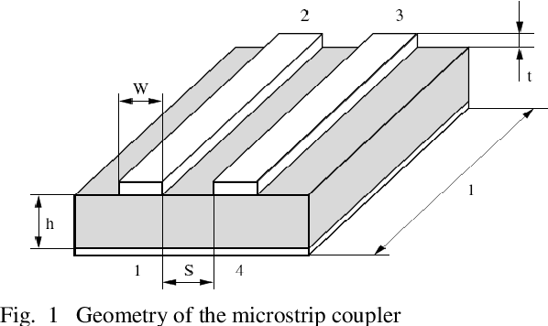
MEEP Simulation for Magnetic Cross Talk and Shielding
The study of capacitive/ inductive coupling in Multi-Conductor Transmission Lines will provide useful knowledge about the Radiated/ Conducted Emissions and Susceptibility.
The generator-receptor model is well suited for studying Electromagnetic Interference and Electromagnetic Compatibility of Magnetic Transmission Lines.
The results can be compared with mathematical formulas to build linear circuit models for cross talk between Magnetic Transmission Lines.
The aim will be to minimize Electromagnetic Radiation; that can be picked up by unintentional receivers like digital Computers.

Slide 41
Limitations of MEEP simulations
MEEP (2016) can not be used to model these magnetic effects:
Magnetostriction
Accoustic effects
Magnetoresistance
Magnetohydrodynamics
Gravitomagnetism
Optical Effects

Slide 42
Conclusion and Scope for Further Work
The conventional reluctance model is not accurate for the modeling of magnetic circuits. It must be replaced by Magnetic Transmission Line Model for accurate modeling of such inhomogeneous, dispersive, non-linear structures.
The power invariant Magnetic Transmission Line model can also be used for accurate modeling of
AC and DC Machines
Micro-strip Antennas
Waveguides
Gyromagnetic Transmission Lines

Slide 43
References
[1] J. B. Faria, Multimodal propagation in multiconductor transmission lines. J. Electromag. Waves Appl. 2014, p. 1677–1702
[2] J. B. Faria, Formulation of Multiwire Magnetic Transmission-Line Theory, Progress in Electromagnetics Research B, Vol. 49, 2013, p. 177–195.
[3] J. B. Faria, Matrix theory of wave propagation in hybrid electric/magnetic multiwire transmission line systems, Journal of Electromagnetic Waves and Applications, Vol. 29, No. 7, 2015, p. 925–940.
[4] J. B. Faria, A physical model of the ideal transformer based on magnetic transmission line theory, Journal of Electromagnetic Waves and Applications, Vol. 27, No. 3, 2013, p. 365–373.
[5] J. B. Schneider, Understanding the Finite-Difference Time-Domain Method, 2017, p. 33-74.
[6] A. Oskooi, D. Roundy, M. Ibanescu, P. Bermel, J.D. Joannopoulos, and S.G. Johnson, MEEP: A flexible free-software package for electromagnetic simulations by the FDTD method, Computer Physics Communications, Vol. 181, 2010, p. 687-702.
[7] J. B. Faria, Complex reluctance of inhomogeneous Euler-Cauchy tubular ferrites taking into account frequency dependent complex permeability, Progress In Electromagnetics Research M, Vol. 25, 2012, p. 71–85.
[8] C. Paul, K. Whites and S. Nasar, Introduction to electromagnetic fields, 4th ed. Boston: WCB/McGraw-Hill, 1998, p.586-589.
[9] B. Sevcik and L. Brancık, Time-Domain Simulation of Nonuniform Multiconductor Transmission Lines in Matlab, International Journal of Mahematics and Computers in Simulation, Vol.5, No. 2, 2011, p. 1-8.

Slide 44
References
[10] G. Antonini, A general framework for the analysis of metamaterial transmission lines. Prog. Electromagn. Res. B., 2010, p. 353–373
[11] C. Caloz and T. Itoh, Electromagnetic Metamaterials: Transmission Line Theory and Microwave Applications, Wiley-IEEE Press, 2006, p. 27-58.
[12] IEEE, Standard for Validation of Computational Electromagnetic (CEM) Computer Modeling and Simulation, and Recommended Practice, Part I, IEEE, June 2008.
[13] C. Paul, Introduction to Electromagnetic Compatibility, 2nd ed. Kentucky: John Wiley and Sons, 2006, p. 559-710.
[14] L. Er-Ping, Computational Electromagnetics for Electromagnetic Compatibility/ Signal Integrity Analysis, IEEE EMC DL Talk, University of Missouri, 2008.
[15] T. C. Edwards and M. B. Steer, Foundations for Microstrip Circuit Design, 4th ed. Wiley-IEEE Press, 2016, p. 576-607.
[16] J. Dickens and A. Neuber, Material selection considerations for coaxial, ferrimagnetic-based nonlinear transmission lines, Journal of Applied Physics, 113, 064904, 2013, p. 1-5.
[17] J. Parson, A. Neuber, J. Dickens and J. Mankowski, Investigation of a stripline transmission line structure for gyromagnetic nonlinear transmission line high power microwave sources, Review of Scientific Instruments, 87, 034706, 2016, p. 1-7.

